Slide 1
HACKJKLU V4.O
Problem Statement : A2
Problem Statement Title: Crime Mapping and Predictive
Analysis System for Enhanced Policing
Theme: Sustainability and Environment
Team Name : Debugging Wizards

Slide 2
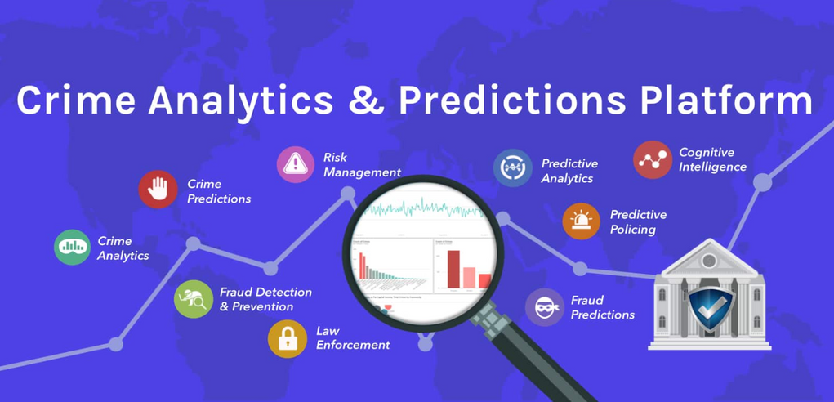
TITLE
Crime Mapping and Predictive Analysis System for Enhanced Policing:
Intelligent Crime Mapping & Predictive Analytics System
🔹 Crime Hotspot Mapping
Integrates Crime data for real-time, color-coded visualizations
Filters based on time, and crime type
🔹 Predictive Crime Analytics
Analyzes criminal behavior patterns
Considers seasonal trends & socio-economic factors
Forecasts potential crime occurrences
🔹 Automated Patrol Planning
Optimizes patrol routes using AI
Enhances women's safety through strategic deployment
Identifies accident-prone areas using iRAD & CCTNS datasets
🔹 Actionable Insights for Law Enforcement
Efficient resource deployment for proactive crime prevention
Role-based access control for sensitive documents

Slide 3
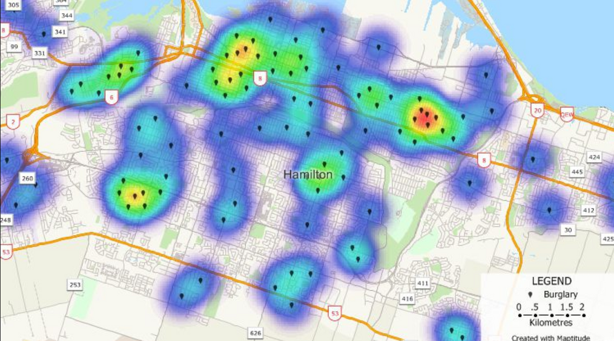
IDEA / SOLUTION
Our solution is an advanced Crime Detection System designed to improve law enforcement efficiency. It analyzes crime data to pinpoint high-risk areas and optimize police patrol routes. Additionally, it offers real-time alerts and predictive insights to help prevent crimes before they happen.
1.Real-time Crime Heatmaps – Dynamically visualizing areas with high crime activity.
2. Predictive Crime Analysis – AI predicts future crime hotspots using historical data.
3. Automated Patrol Optimization – Police routes are modified according to crime density.
4. Women’s Safety Alerts – Highlights high-risk areas and recommends safer paths.

Slide 4

INNOVATION AND UNIQUENESS
1. AI-Driven Crime Prevention: Employs machine learning algorithms to forecast crime patterns using past data.
2.Interactive Crime Heatmaps: Provides color-coded visuals to showcase regions of crimes.
3.Emergency Response Coordination: Guarantees quicker police deployment to areas with higher risk.
4.Enhancements for Women’s Safety: AI recommends optimal patrol locations and safe travel paths.
5. Enhanced Route Optimisation: Manages the routes for patrolling with the help of AI.

Slide 5
Techincal Approach
Data Collection: extraction of FIR and crime records from CCTNS, iRAD and public reports.
Data Pre-processing: cleaning and structuring data for analysis.
AI risk scoring and prediction: applying ML models to analyze crime trends.
Visualization (crime heatmaps & patrol optimization): GIS based mapping with the help of Google Maps API.
Alerts & Police Response: Sending insights to law enforcements.
Technologies used:
Google Maps API an GIS Mapping
Tensorflow and Scikit-learn for predictive policing
3. Python & Django.
4. HTML and React.js

Slide 6
Impact and Benefits
Using AI implementation
Predicts crime- prone areas advance.
Smart patrols based on AI-driven heatmaps.
Faster emergency response using real-time AI alerts.
AI-driven, better coverage.
Decreasing crime rates from data-driven law enforcements.
Enhance Route Planning using AI.

Slide 7


Research and Reference
Crime data sources:
NCRB (National Crime Records Bureau
CCTNS (Crime and Criminal Tracking Network and Systems)
iRAD (Integrated Road Accident Database)
Government Open Data Portals
Research and reference:
Kaggle databases
Sample data.

